Slide 1
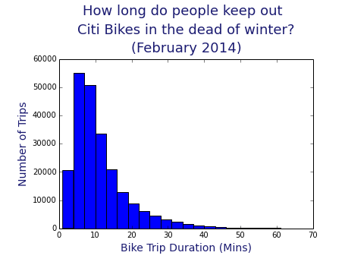

Slide 2
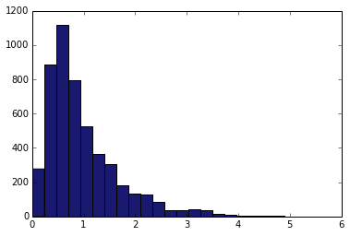
How far do they go?
Number of people
Miles between bike stations

Slide 3
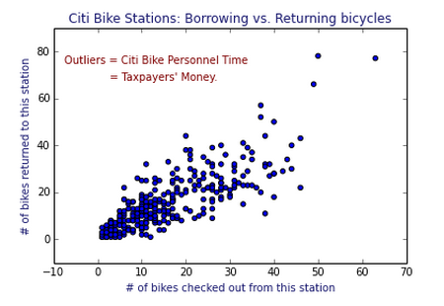

Slide 4
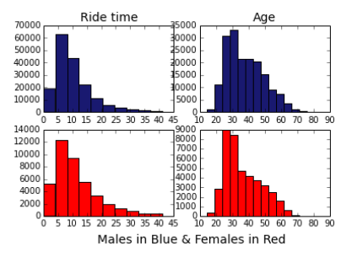

Slide 5
The slide show over is over.

Slide 6
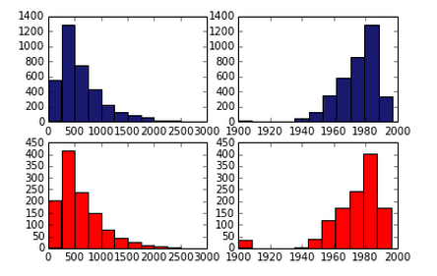

Slide 7
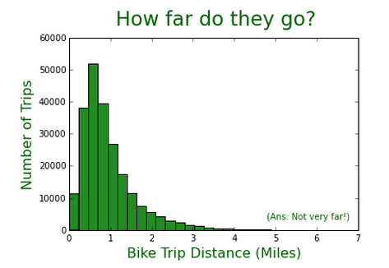

Slide 8
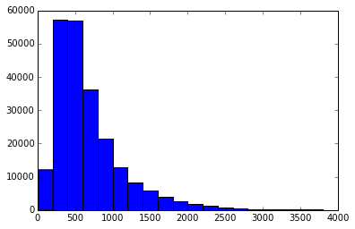
How long do people keep out citi bikes in the dead of winter?
(February 2014)
Number of people
Time with bike (in seconds)

Slide 9
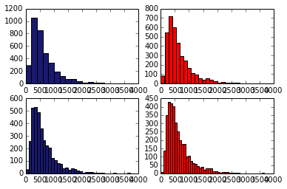
Don’t these look like
they could be 4 different things?
Guys spending time on bikes
They aren’t.

